Slide 1

Module 6
Recurrent Neural Networks
Notes:
Guidelines
Use section headers to chunk content in your presentation.
Use the same style of section header throughout your presentation.
Keep your title to no more than 2 lines.

Slide 2
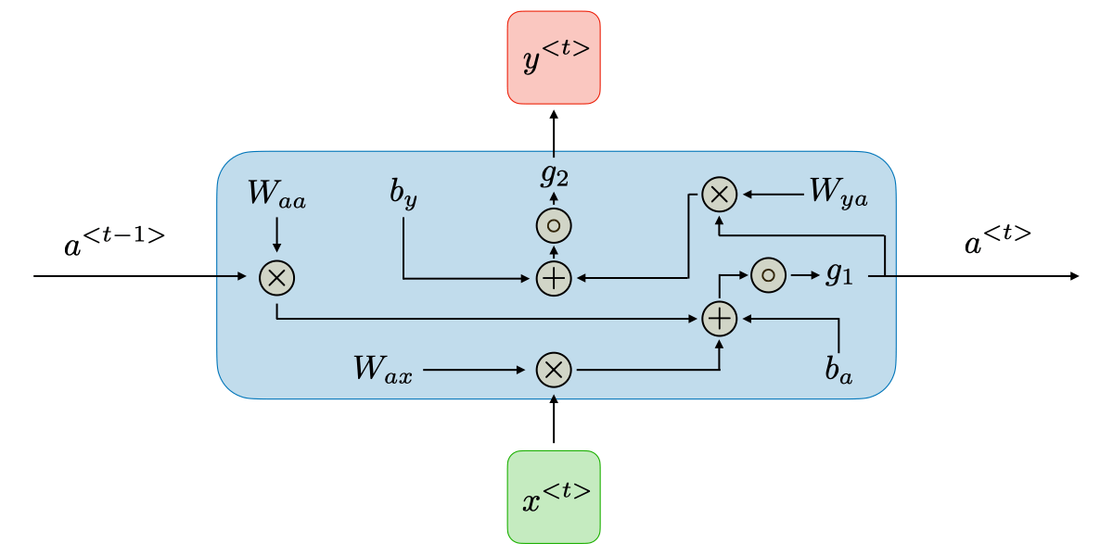
DL: RNNs
Notes:
Guidelines
Use a title slide at the beginning of your presentation. There are 9 variations of title slides to choose from.
If you will have a series of slideshows, we recommend using the same style of title slide for each presentation.
Keep your title to no more than 2 lines.
Do not change the font style or font size of the title or subtitle.

Slide 3
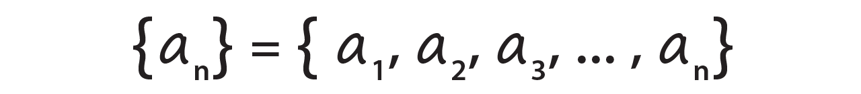
Sequences
Enumerated collection of objects
Repetitions in sequences are allowed and order matters.
Time series, speech rely on changes over a time interval

Slide 4
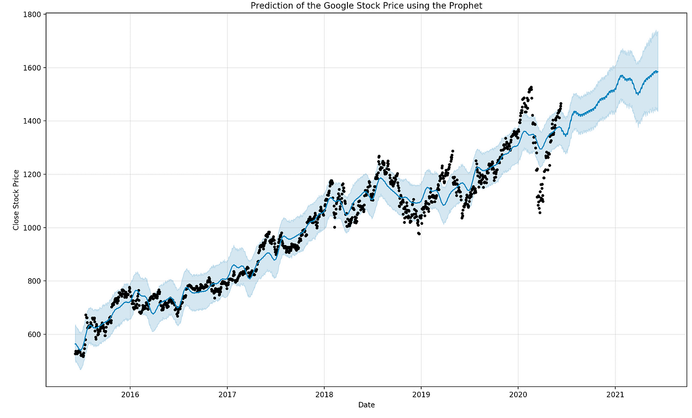
Sequences Examples
Stock price, financial instruments, inventory predictions

Slide 5

Sequences Examples
Natural language processing, LLMs

Slide 6
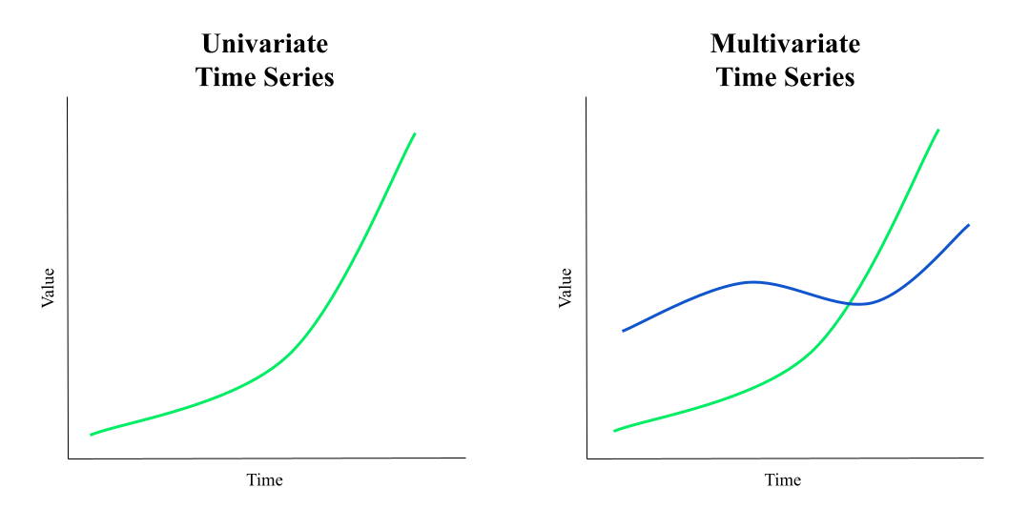
Univariate vs Multivariate Sequences
We may need to understand more than one sequence

Slide 7
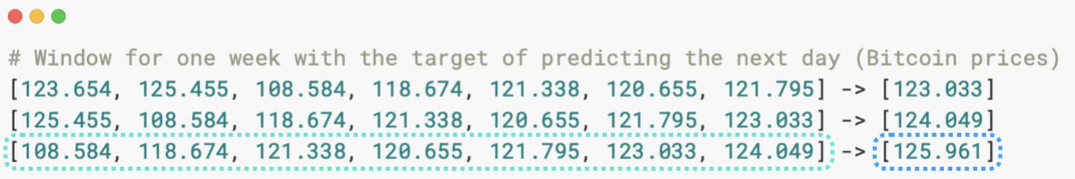
Feature Creation
We can use a window size (width, length, step) and horizon
This method is called the “sliding window”
window size = 7, horizon = 1

Slide 8
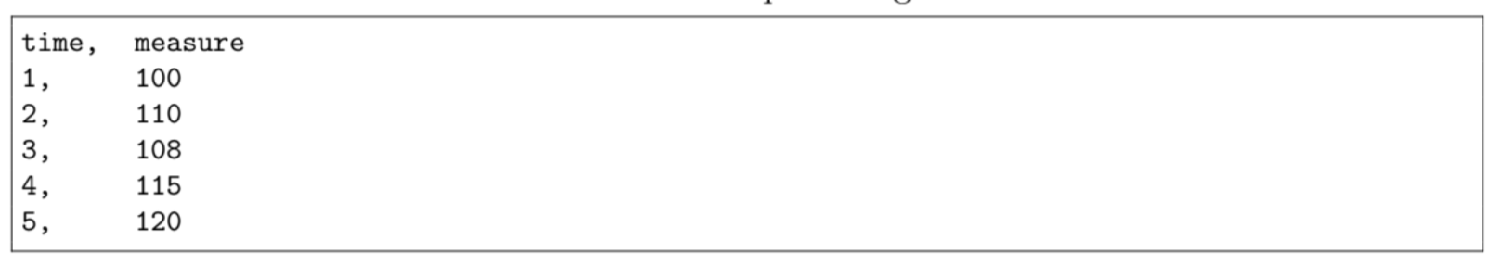
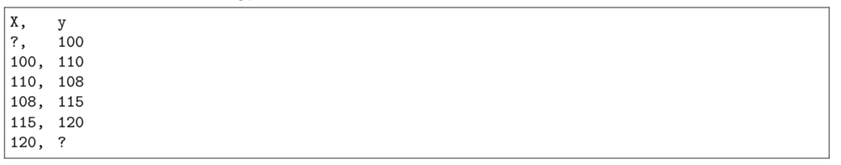
Feature Creation
Using a window size (input width) and horizon (label width)
This method is called the sliding window
LAG 1 feature (window size = 1, horizon = 1)

Slide 9
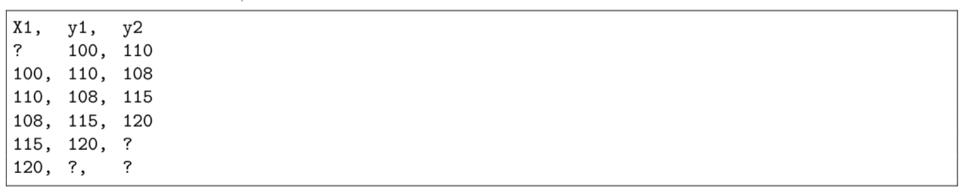
Feature Creation
Using a window size (input width) and horizon (label width)
This method is called the sliding window
LAG 1 feature (window size = 1, horizon = 2)

Slide 10
Python
Notes:
Guidelines
Use a title slide at the beginning of your presentation. There are 9 variations of title slides to choose from.
If you will have a series of slideshows, we recommend using the same style of title slide for each presentation.
Keep your title to no more than 2 lines.
Do not change the font style or font size of the title or subtitle.

Slide 11
Creating Lags on Multiple Features
Using the sliding window method on multiple predictors can help
The windows used can be different
LAG 1 feature (window size = 1, horizon = 2)

Slide 12
Python
Notes:
Guidelines
Use a title slide at the beginning of your presentation. There are 9 variations of title slides to choose from.
If you will have a series of slideshows, we recommend using the same style of title slide for each presentation.
Keep your title to no more than 2 lines.
Do not change the font style or font size of the title or subtitle.

Slide 13
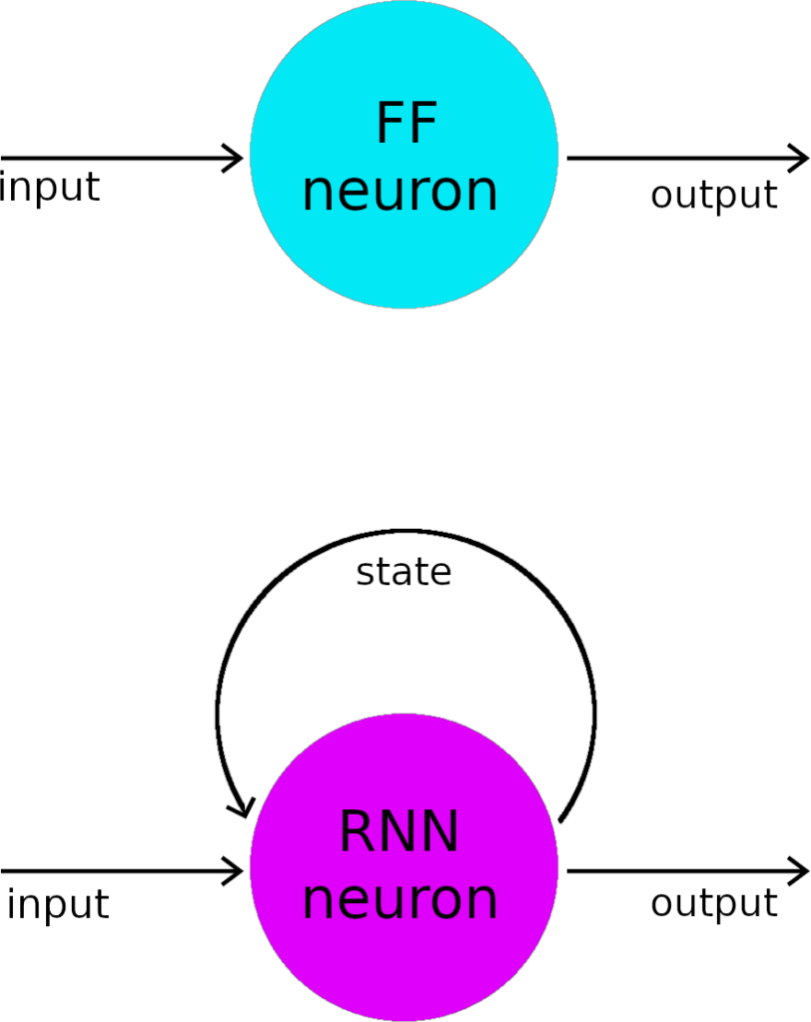
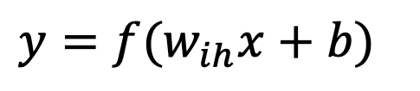
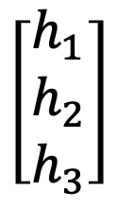
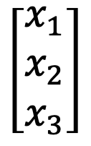
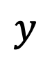
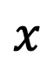
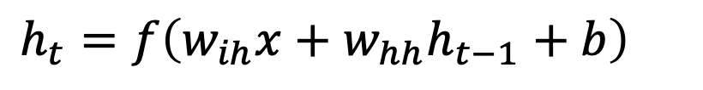
Recurrent Neural Networks
RNN neurons contain a feedback loop to receive sequence inputs
The neurons (units) can be rolled to account for a sequence.
$$x$$
$$y$$
$$y=f(w_{ih}x+b)$$
$$\left[\begin{matrix}x_{1} \\ x_{2} \\ x_{3}\end{matrix}\right]$$
$$\left[\begin{matrix}h_{1} \\ h_{2} \\ h_{3}\end{matrix}\right]$$
$$h_{t}=f\left(w_{ih}x+w_{hh}h_{t−1}+b\right)$$

Slide 14
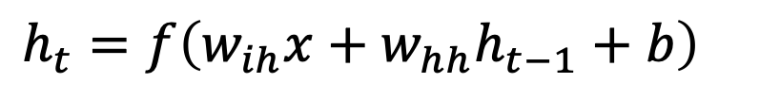
Recurrent Neural Networks
RNN neurons contain a feedback loop to receive sequence inputs
The neurons (units) can be rolled to account for a sequence.
$$h_{t}=f\left(w_{ih}x+w_{hh}h_{t−1}+b\right)$$

Slide 15

Recurrent Neural Networks
RNN neurons contain a feedback loop to receive sequence inputs
The neurons (units) can be rolled to account for a sequence.

Slide 16
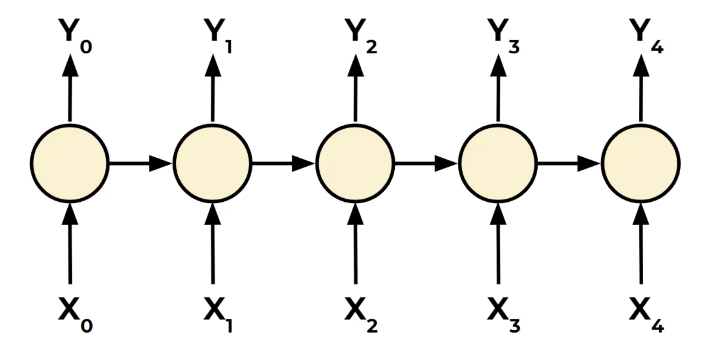
Recurrent Neural Networks
Sequence to Sequence (seq2seq)

Slide 17
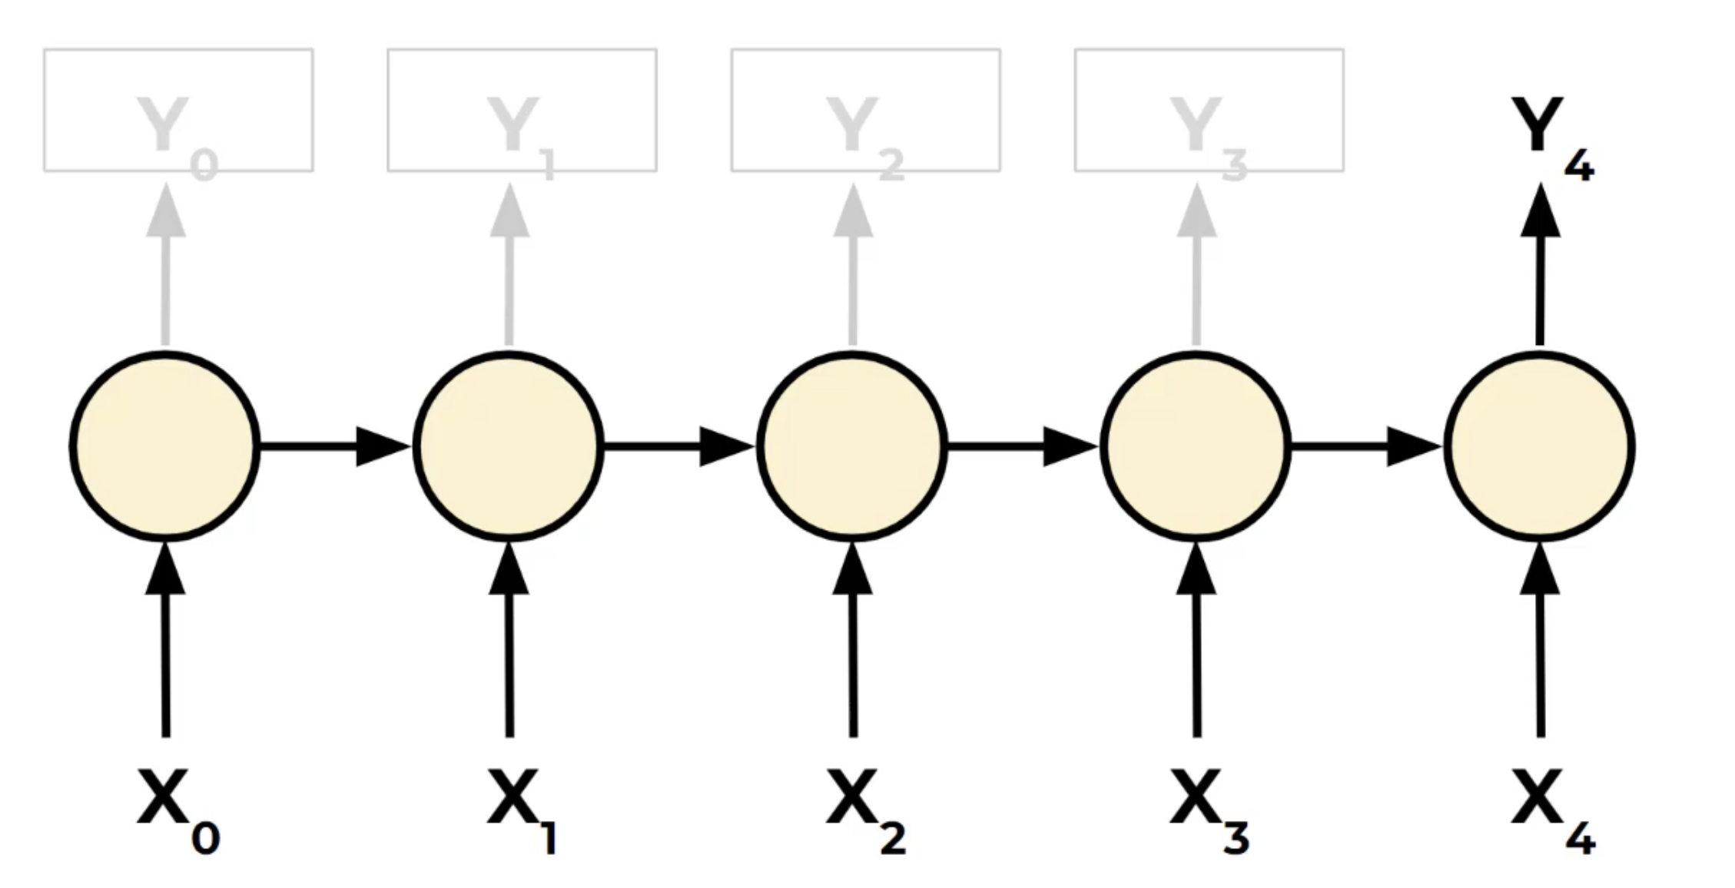
Recurrent Neural Networks
Sequence to Vector (seq2vec)

Slide 18
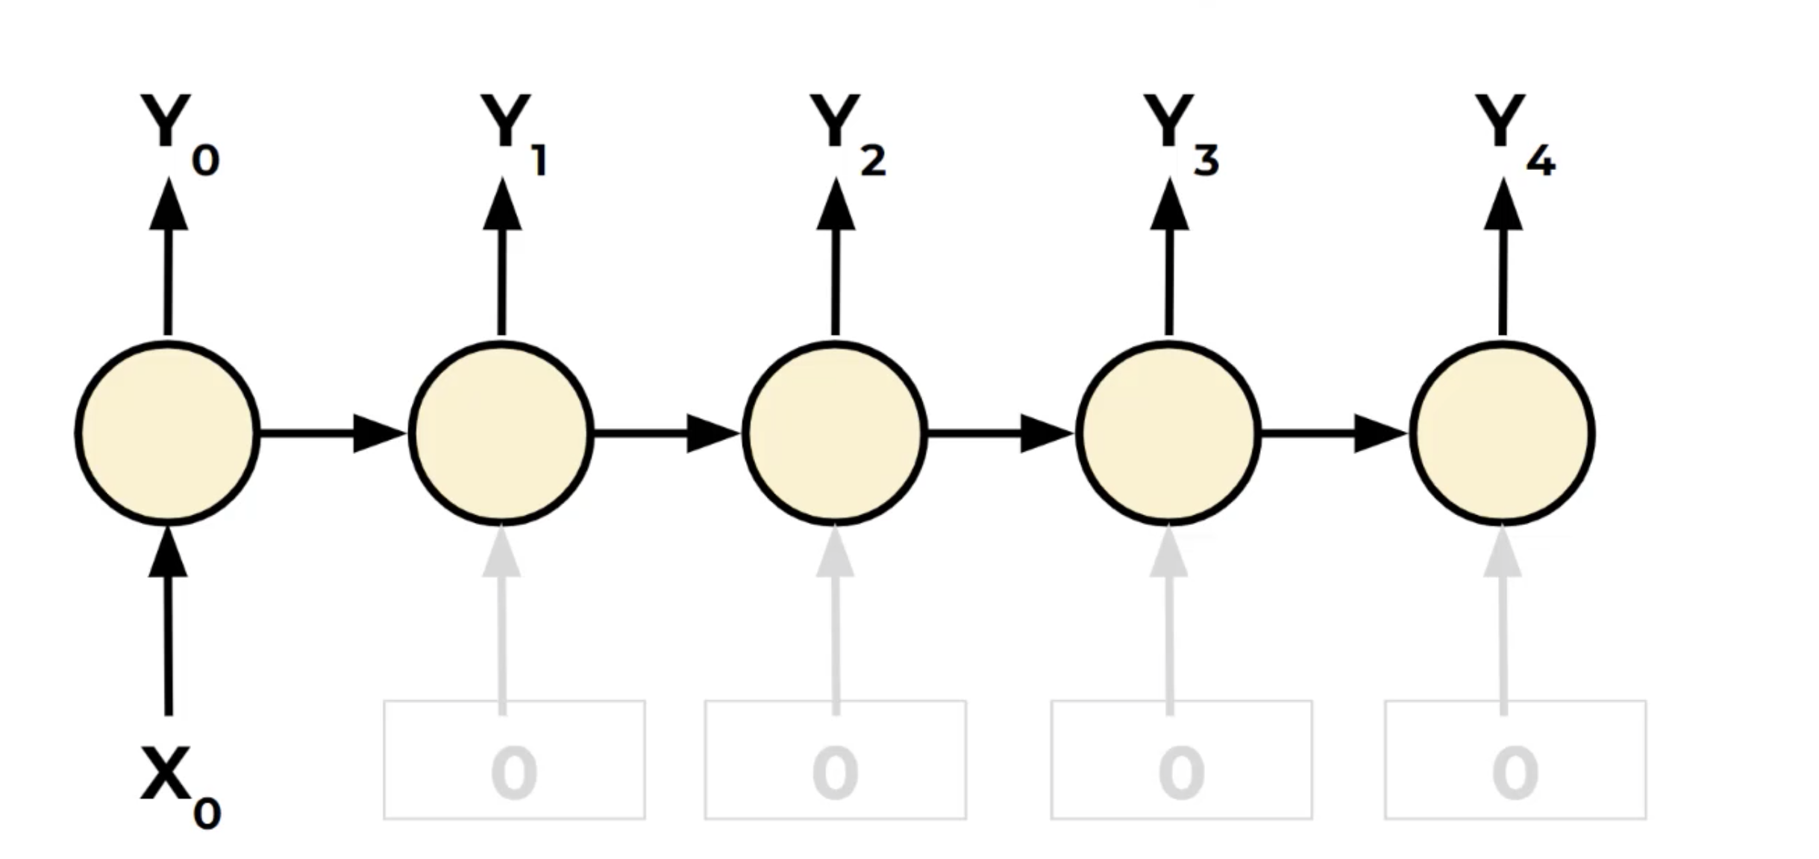
Recurrent Neural Networks
Vector to Sequence (vec2seq)

Slide 19
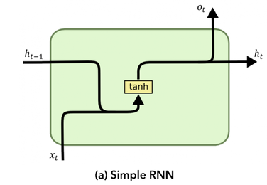
Recurrent Neural Networks
Elman network
Tanh activation
HIDDEN STATE

Slide 20
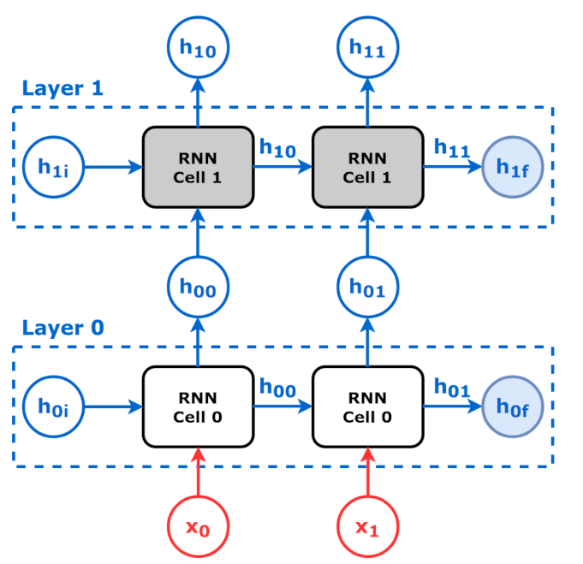
Stacked RNN Architecture
Stacked (deep) RNNs are composed of multiple RNNs stacked one above the other.

Slide 21
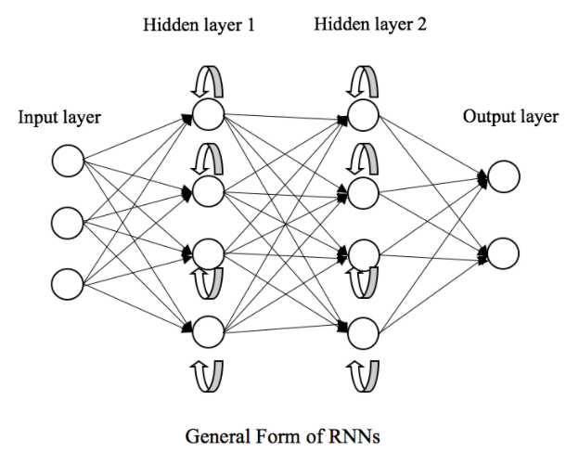
RNN Architecture
We can construct layers of RNN neurons (units)
We can also stack layers (need to return the sequences)

Slide 22
Python
Notes:
Guidelines
Use a title slide at the beginning of your presentation. There are 9 variations of title slides to choose from.
If you will have a series of slideshows, we recommend using the same style of title slide for each presentation.
Keep your title to no more than 2 lines.
Do not change the font style or font size of the title or subtitle.

Slide 23
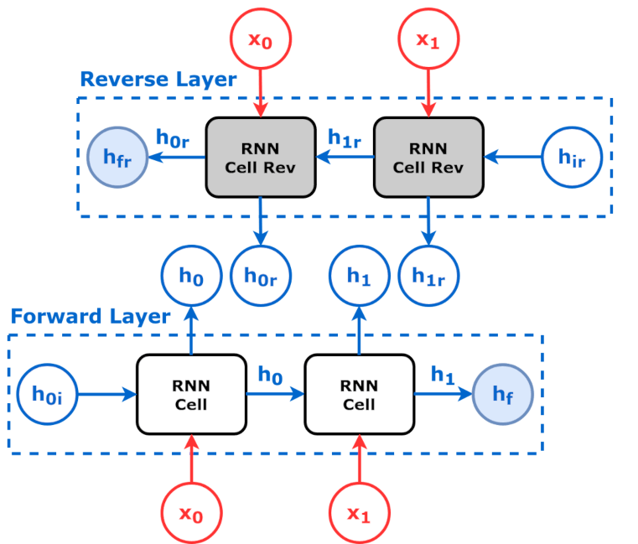
Bi-directional RNN Architecture
Composed of two RNNs
The input sequence (RNN # 1) and opposite direction (RNN # 2)

Slide 24
Python
Notes:
Guidelines
Use a title slide at the beginning of your presentation. There are 9 variations of title slides to choose from.
If you will have a series of slideshows, we recommend using the same style of title slide for each presentation.
Keep your title to no more than 2 lines.
Do not change the font style or font size of the title or subtitle.

Slide 25
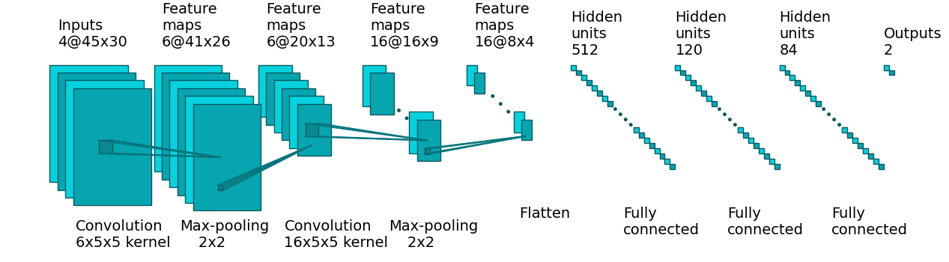
CNN for Sequences
CNNs excel at capturing local dependencies (e.g., trends, peaks).
Effective in repeating patterns regardless of position in sequence.
Fewer parameters than RNNs; allows parallel computation.

Slide 26
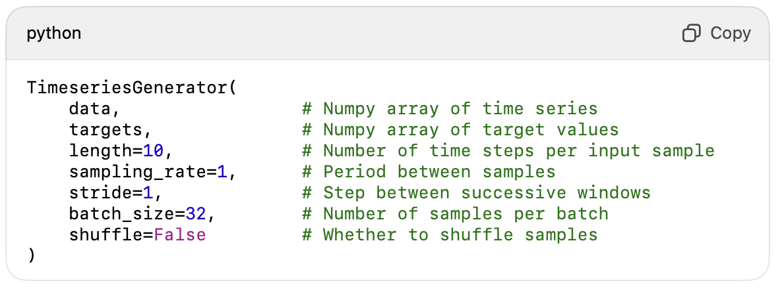
TimeSeriesGenerator
Converts raw time series into supervised learning format
Efficient for memory use and model training
Supports sliding window logic

Slide 27
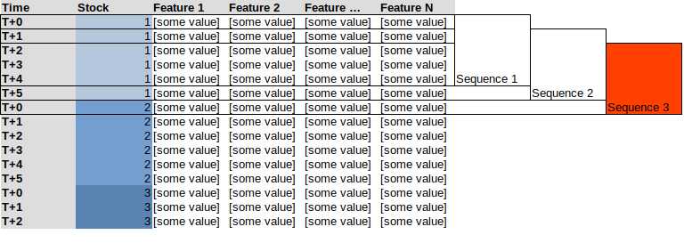
TimeSeriesGenerator
Converts raw time series into supervised learning format
Efficient for memory use and model training
Supports sliding window logic

Slide 28
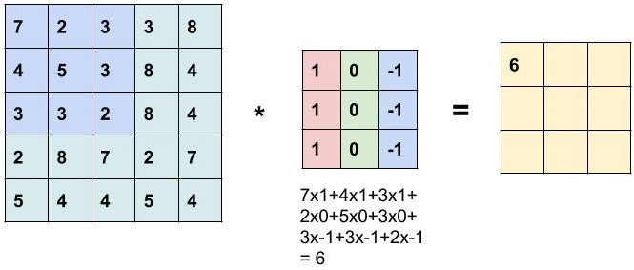
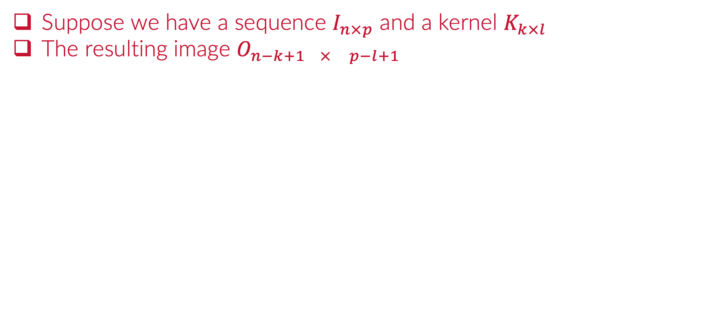
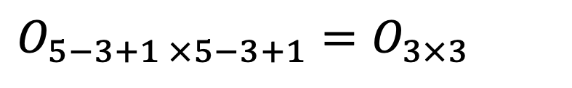
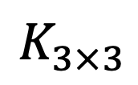
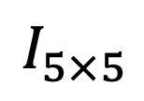
Review: Convolutions
Suppose we have a sequence $I_{n×p}$ and a kernel $K_{k×l}$
The resulting image $O_{n−k+1 × p−l+1}$
$$I_{5×5}$$
$$K_{3×3}$$
$$O_{5−3+1 ×5−3+1}=O_{3×3}$$

Slide 29
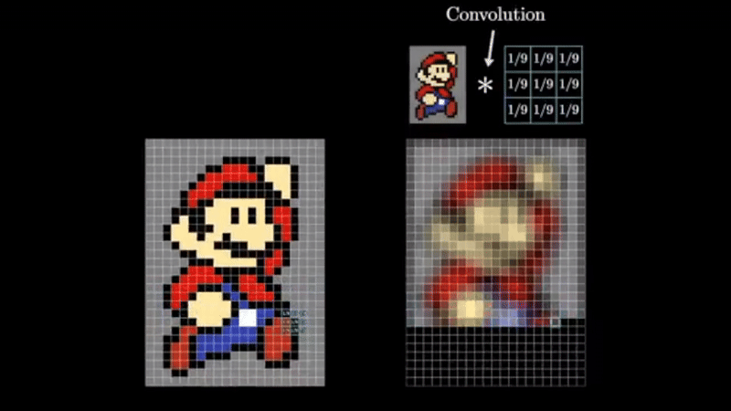
Review: Convolutions
Suppose we have a sequence $I_{n×p}$ and a kernel $K_{k×l}$
The resulting image $O_{n−k+1 × p−l+1}$

Slide 30
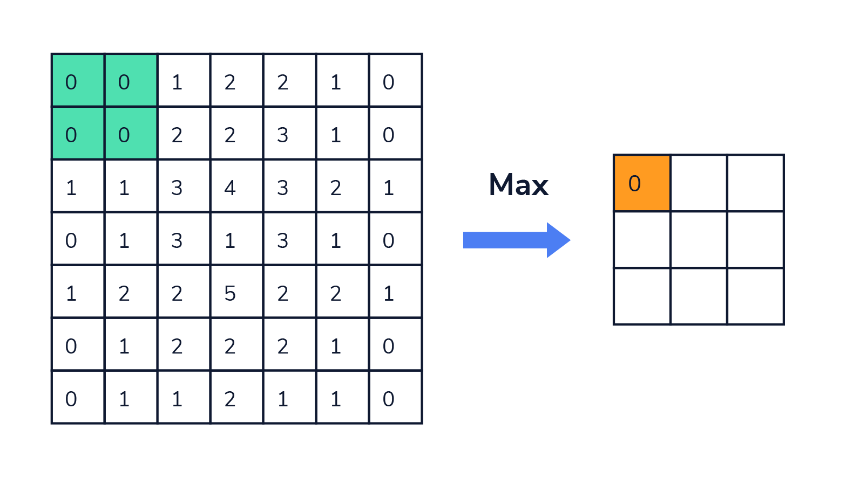
Review: Pooling
Pooling is also used to downsample the sequences.
Pooling filters keep the important parts of the sequence.
Max, Min and Average Pooling Filters are the most common

Slide 31
Python
Notes:
Guidelines
Use a title slide at the beginning of your presentation. There are 9 variations of title slides to choose from.
If you will have a series of slideshows, we recommend using the same style of title slide for each presentation.
Keep your title to no more than 2 lines.
Do not change the font style or font size of the title or subtitle.

Slide 32

Limitations of RNNs
Struggle with long-term dependencies due to vanishing gradients.
Attention (weights or scores for each hidden state)
Training can be slow and unstable.
Can be replaced by more advanced RNN-type architectures such as LSTMs and GRUs

Slide 33
Limitations of CNNs on Sequences
Struggle to capture long-range temporal dependencies
CNNs are stateless and don’t carry information across time steps
Dilations (stride [t, t+2, t+4] ) can help
Unlike RNNs/LSTMs, they don’t “remember” past context

